Slide 1
Automatic Keyphrase Extraction from Scientific Chinese Medical Abstracts Based on Character-Level Sequence Labeling
Liangping Ding
National Science Library, Chinese Academy of Sciences
University of Chinese Academy of Sciences

Slide 2
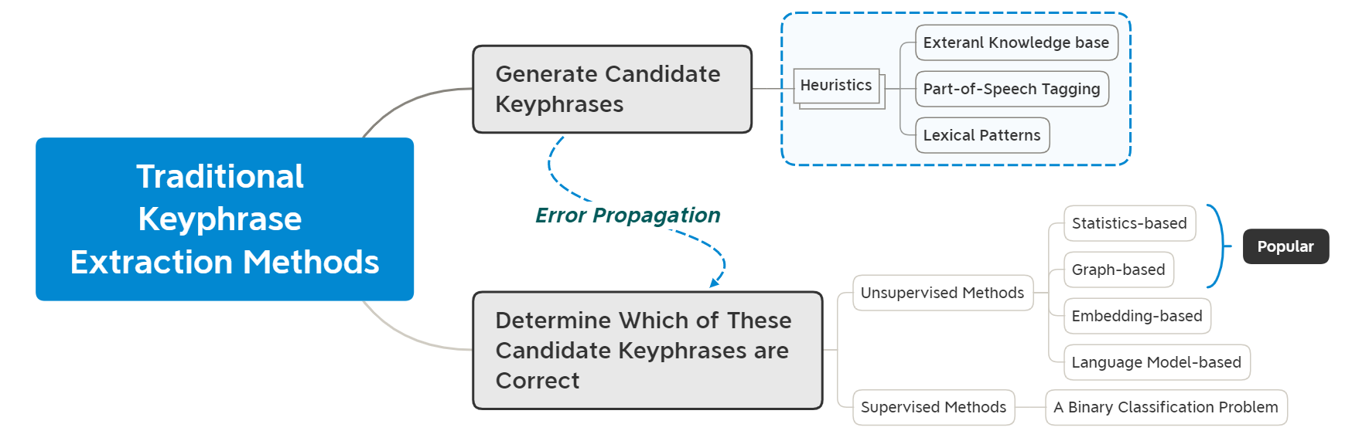
Traditional Keyphrase Extraction

Slide 3
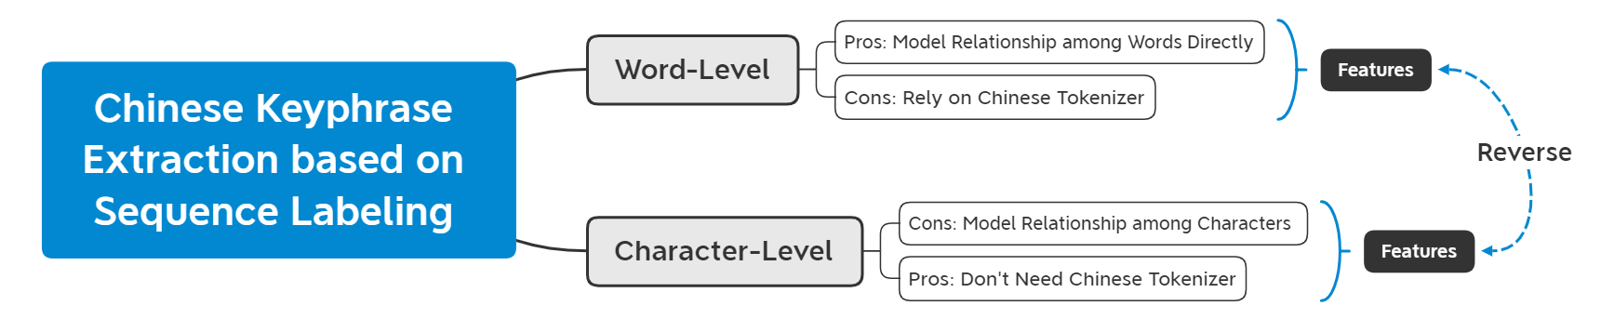
Sequence Labeling Task Formulation
Text: 不同产地车前草中总苯乙醇苷和毛蕊花糖苷含量测定。
Keyphrases: 车前草 苯乙醇苷 毛蕊花糖苷
Missing Keyphrase
不同 | 产地 | 车前草 | 中总苯 | 乙醇 | 苷 | 和 | 毛蕊 | 花 | 糖苷 | 含量 | 测定。
O | O | B | O | O | O | O | B | I | I | O | O
Word-Level
Character-Level
不 | 同 | 产 | 地 | 车 | 前 | 草 | 中 | 总 | 苯 | 乙 | 醇 | 苷 | 和 | 毛 | 蕊 | 花 | 糖 | 苷 | 含 | 量 | 测 | 定 | 。
O | O | O | O | B | I | I | O | O | B | I | I | I | O | B | I | I | I | I | O | O | O | O | O

Slide 4
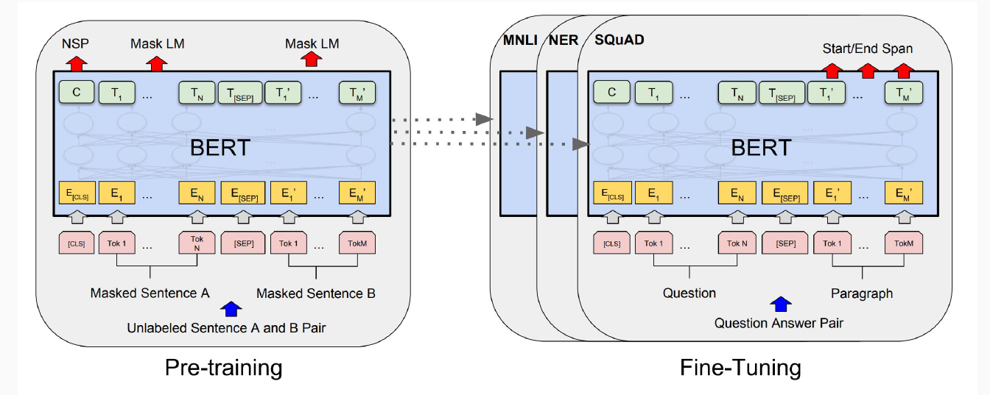
Pretrained Language Model for Chinese Keyphrase Extraction
Composition of Vocab for Chinese BERT | Examples
Chinese Characters | 鸪, 鸭, 鸳, 鸵, 鸽, 鸾
English tokens | wordpress, office
Other Special Characters | τ, υ, φ, χ, ψ, ω

Slide 5
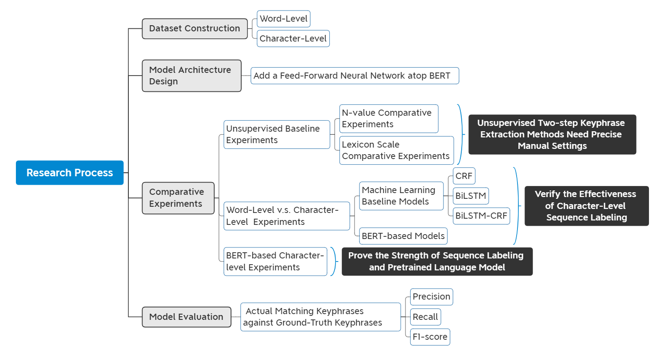
Research Process

Slide 6
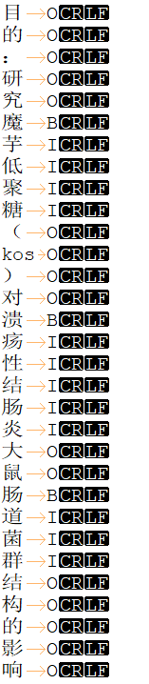
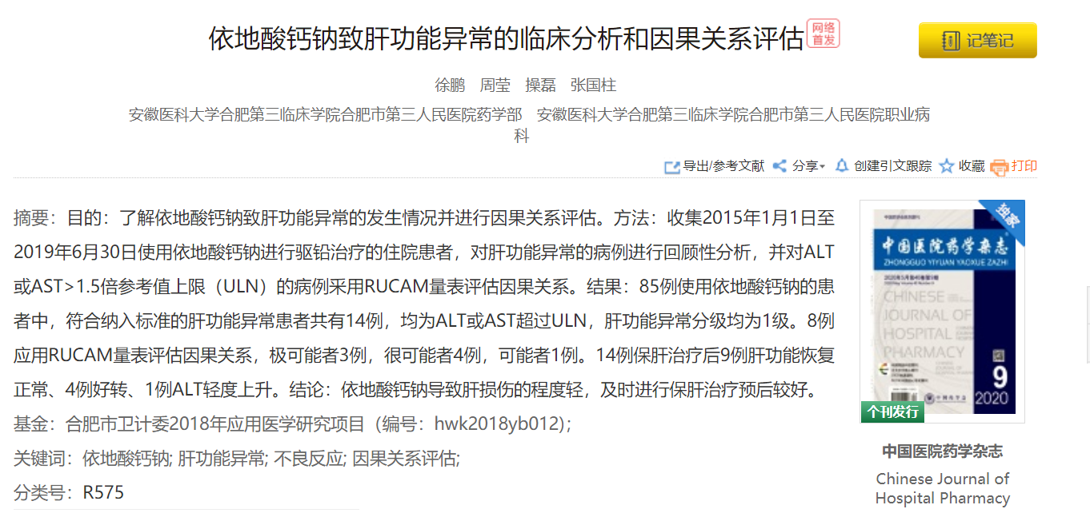
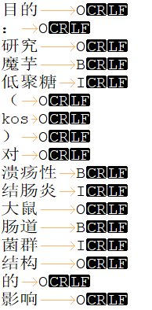
Dataset Construction
Titile:
Abstract:
Keyphrases:
Word-Level
Data Set | Num of Records
Training Set | 100,000
Dev Set | 6,000
Test Set | 3,094
Character-Level

Slide 7
Dataset Construction
Character-Level IOB Generation Results on Data Sets
Data Set | Precision | Recall | F1-score
Training Set | 99.18% | 99.42% | 99.30%
Development Set | 99.13% | 99.54% | 99.34%
Test Set | 99.15% | 99.56% | 99.36%
Some Tricks:
① Containment
Text:穴位注射罗哌卡因分娩镇痛对产妇产程的影响
Keyphrases: 分娩 分娩镇痛
② Overlapping
Text: 术中经食管超声心动图对心脏瓣膜置换术后即刻人工瓣膜功能异常的诊断价值
Keyphrases: 人工瓣膜 瓣膜功能异常
Word-Level IOB Generation Results on Data Sets
Data Set | Precision | Recall | F1-score
Training Set | 91.15% | 96.93% | 93.96%
Development Set | 91.35% | 97.03% | 94.11%
Test Set | 90.99% | 97.11% | 93.95%
Notes:
dfd fgg

Slide 8
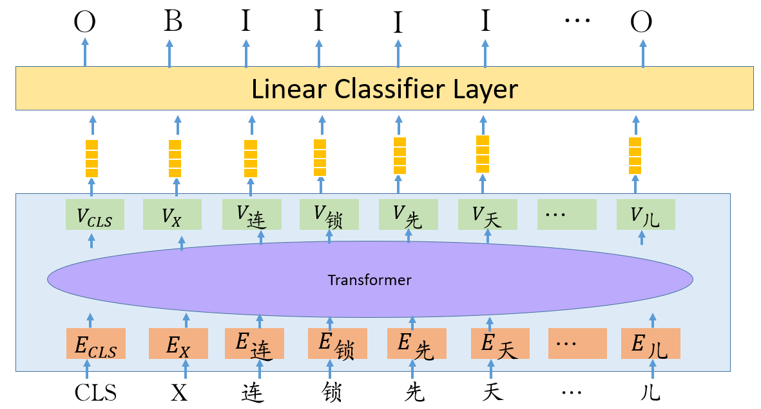
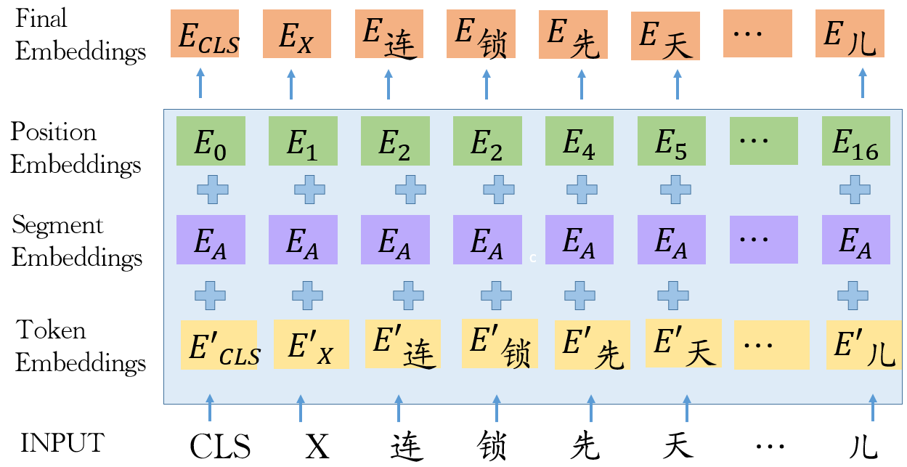
Model Architecture Design
Character-Level Keyphrase Extraction Model Architecture
Input Representation of Keyphrase Extraction Model
Meaningful Single Chinese Characters
Meaningful Single Chinese Characters | Examples
Chemical Elements | 氢（hydrogen），氦（helium）
Organs | 胃（stomach），脾（spleen）
Animals | 鼠（mouse），鸡（chicken）

Slide 9
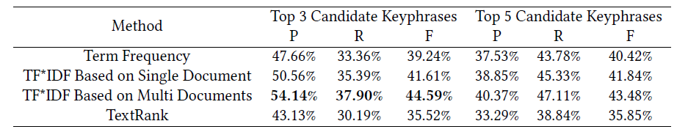
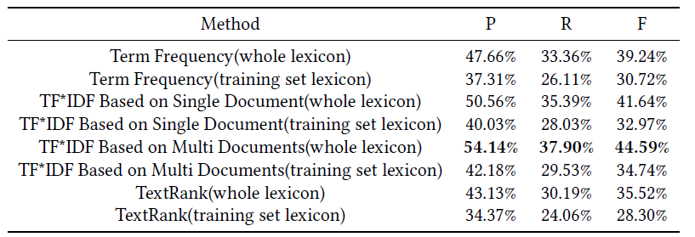
Comparative Experiments & Model Evaluation
N-value Comparative Experiments of Unsupervised Baseline Methods
Analysis:
Traditional unsupervised two-step keyphrase extraction methods are sensitive to N value and the lexicon scale. So these methods need precise manual settings.
Lexicon Scale Comparative Experiments of Unsupervised Baseline Methods

Slide 10
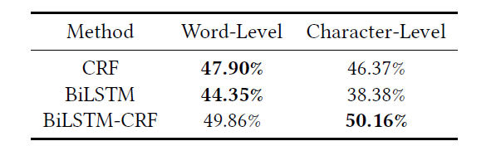
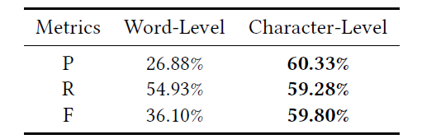
Comparative Experiments & Model Evaluation
Word-Level and Character-Level Comparative Experiments
of Supervised Machine Learning Baselines
Analysis:
BiLSTM-CRF is a more powerful model to capture the contextual relationship among characters to make up for the disadvantage that character-level formulation doesn't model the relationship among words directly.
Word-Level and Character-Level Comparative Experiments
of BERT-based Models
Analysis:
Chinese BERT learns good semantic representation of Chinese characters in the pretraining process. It can maximize the advantages of the character-level sequence labeling formulation and avoid its shortcomings.

Slide 11
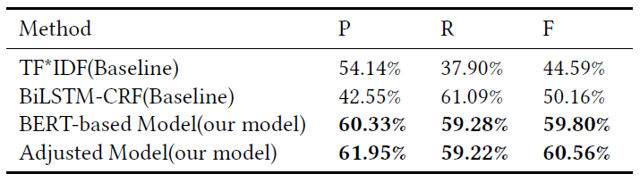
Comparative Experiments & Model Evaluation
Analysis:
sequence labeling formulation is beneficial for Chinese keyphrase extraction task
Analysis:
pretrained language model is powerful
Note:
Adjusted model removes single Chinese characters that are not in the user-defined lexicon

Slide 12
Take Away
We regard AKE from scientific Chinese medical abstracts as a character-level sequence labeling task and fine-tune the parameters of BERT to make it adapt to our large-scale keyphrase extraction dataset.
We design comparative experiments against word-level and character-level sequence labeling formulation for Chinese keyphrase extraction to verify the effectiveness of character-level formulation
We process data from Chinese Science Citation Database and construct a large-scale character-level dataset for automatic keyphrase extraction from scientific Chinese medical abstracts. We make our dataset (AKESCMA) publicly available for the benefits of the research community.

Slide 13
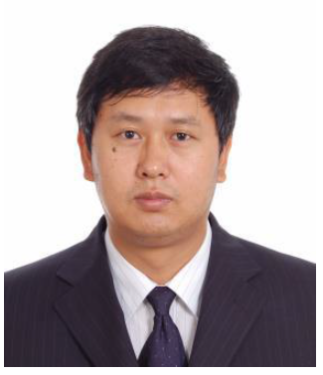

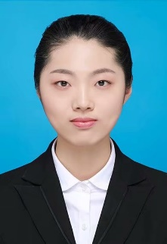

Acknowledgements
Zhixiong Zhang
& Members in our Research Group
Huan Liu
Jie Li
Gaihong Yu

Slide 14
Thank you!
Contact
dingliangping@mail.las.ac.cn

